Slide 1
Kinsella IP Law Tutorial Part 3: Trademark, Trade Secret, and Other
N. Stephan Kinsella
C4SIF.org • StephanKinsella.com
@nskinsella
Via Zoom
May 11, 2023

Slide 2
Cleanup; Territorial Aspects of IP; Copyright Registration
China and IP “theft”
Stop calling patent and copyright “property”; stop calling copying “theft” and “piracy”
Query: You said copyright no longer needs to be registered or have copyright notice. Why did someone tell me copyright had to be registered in the US before filing a lawsuit?
Because it does
17 USC §411
Notice and registration still not required to have copyright
Some advantages to registration (statutory damages, etc.)

Slide 3
IP Law: Overview
Discuss IP LAW (how the law works) instead of IP Policy (whether the law is good or not)
Have already discussed patent (Part 1) and copyright (Part 2)
These do the most damage
Patents distort and impede technological innovation
Thus impoverish the human race
It’s not a Jetsons World
Copyright distorts culture and freedom of expression and the press, and threatens Internet freedom
Also increasingly restricts rights in functional products
Cars, equipment, electronic devices
“Right to repair”

Slide 4
IP Law: Overview
“Types of Intellectual Property”
Copyright (federal)
Patent (federal)
Trademark
State and federal
Trade secret (mostly state)
Others
Boat hull designs
Semiconductor maskwork
Database rights
Moral rights
Special protections e.g. NSA seal, images of certain religious figures
Proposed: newspaper headlines, linking, fashion designs
Defamation (libel and slander) (later)

Slide 5
Trademark
A Trademark is any word, name, symbol, or device or any combination used by a person
Protection of rights in marks used to identify source of goods or services
Distinguishes them from the goods and services of another company
Provides legal protection for a “brand”
Purpose
Allow the public to make informed decisions and to differentiate between competing products and companies.
To protect the providers’ investment in their reputation.

Slide 6
Trademark (cont.)
Supreme Court in Qualitex Co. v. Jacobson Products Co (1995):
"[T]rademark law, by preventing others from copying a source-identifying mark, 'reduce[s] the customer's costs of shopping and making purchasing decisions,' for it quickly and easily assures a potential customer that … the item with this mark … is made by the same producer as other similarly marked items that he or she liked (or disliked) in the past. At the same time, the law helps assure a producer that it (and not an imitating competitor) will reap the financial, reputation related rewards associated with a desirable product."

Slide 7
Trademark (cont.)
Common source identifiers
Brand names
Slogans
Logos
Other types of marks
Sound, color, scent/smell, motion, hologram, configuration/shape

Slide 8
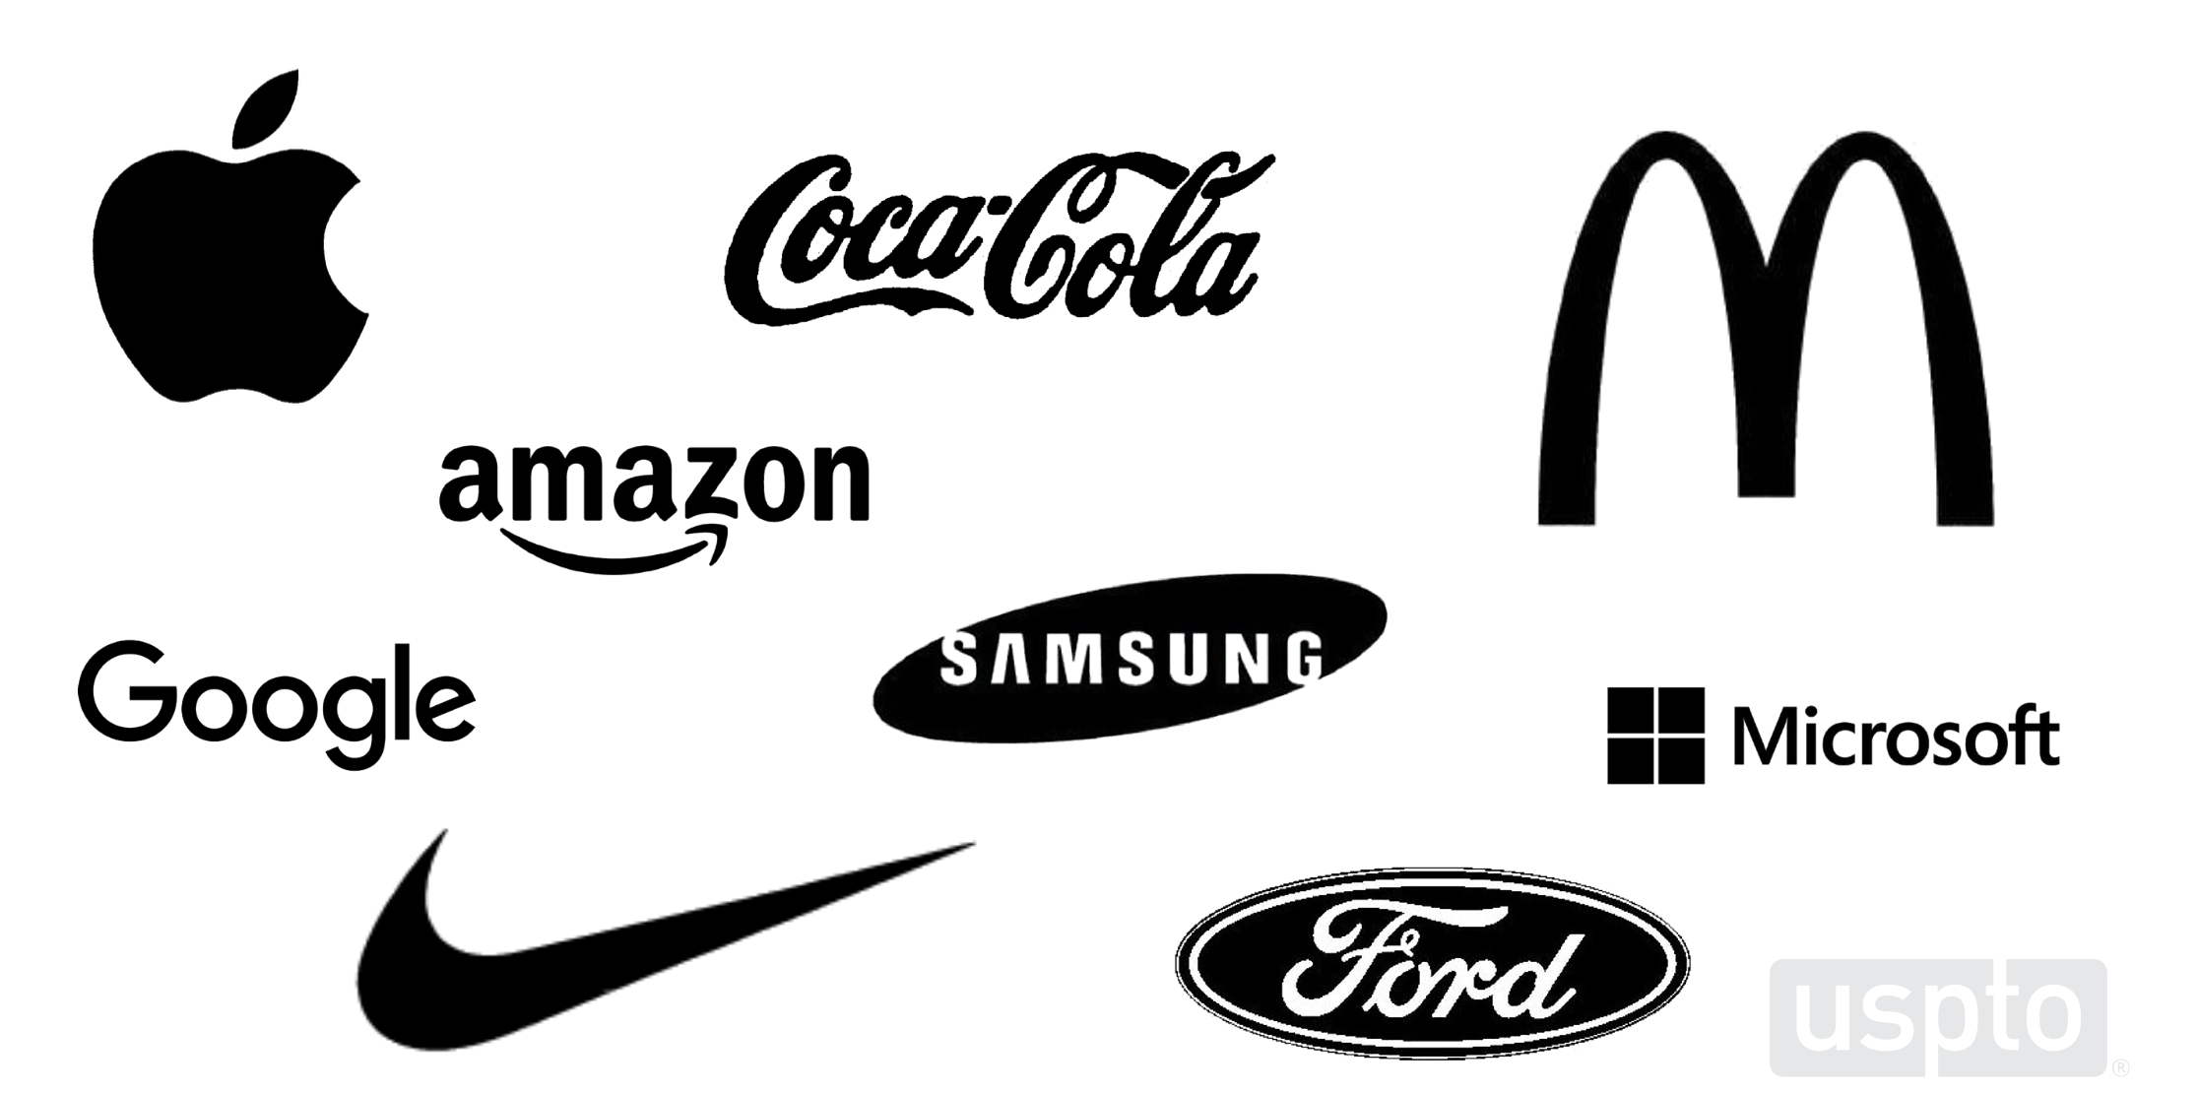
Trademark (cont.)

Slide 9
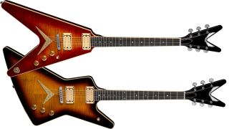
Trademark (cont.)
Court Orders Dean Guitars to Stop Production of Various Models After Losing Legal Battle Against Gibson
Dean must stop producing V, Z and Gran Sport electric guitars after latest ruling in Gibson trademark infringement lawsuit

Slide 10
Trademark (cont.)
Emerged on common law (unlike patent and copyright which are based in statute/legislation)
Largely state-based in the US
Federal trademark law
Patent and copyright authorized in U.S. Const., Art. I, Sec. 8, Cl. 8: Grants Congress power: “To promote the progress of science and useful arts, by securing for limited times to authors and inventors the exclusive right to their respective writings and discoveries.”
Trademark: Art. I, Sec. 8, Cl. 3: gives Congress the power “to regulate commerce with foreign nations, and among the several states, and with the Indian tribes.”
Lanham Act of 1946: Title 15, Ch. 22 of USC
Federal Trademark Dilution Act of 1995
Trademark Dilution Revision Act of 2006

Slide 11
Trademark (cont.)
Can have state common law rights
Arise by use
Or file a state trademark registration
or federal registration
Administered by USPTO
Patents too
Copyright: Library of Congress, Commerce Dept.
Federal registration can be basis of filing in other countries
Madrid System
international registration of trademarks
administered by the International Bureau of WIPO

Slide 12
Trademark (cont.)
Problems
Does not require fraud, only consumer ”confusion”
Does not require confusion, only “likelihood of”
Does not give right to sue to the “likely confused” consumer, but to the trademark owner
“[trademark] rights are closely but ambiguously related to the idea of preventing deception of the consumer. The ambiguity arises from the fact that neither deception nor consequent damages suffered by consumers need be shown in a trademark infringement action. … Moreover, insofar as premised upon protection of the consumer from fraudulent misrepresentation, such actions present the rather anomalous situation of one private person or corporation recovering from another for the latter’s wrongdoing against a third. Thus, in practice trademarks are as much a protection of its holder’s goodwill as a protection of consumers from deception.” Dale A. Nance, “Foreword: Owning Ideas,” Harv. J. L. & Pub. Pol’y 13, no. 3 (Summer 1990) 757–74, p. 758 n.7.

Slide 13
Trademark (cont.)
Problems
Also have antidilution rights now which does not even require a showing of likelihood of consumer confusion
protects famous trademarks from uses that dilute their distinctiveness, even in the absence of any likelihood of confusion or competition

Slide 14
Trade Secrets
The Fourth main type of IP
Also mostly state-based law
Common law
Definition (UTSA)
(3) the term "trade secret" means all forms and types of financial, business, scientific, technical, economic, or engineering information, including patterns, plans, compilations, program devices, formulas, designs, prototypes, methods, techniques, processes, procedures, programs, or codes, whether tangible or intangible, and whether or how stored, compiled, or memorialized physically, electronically, graphically, photographically, or in writing if—
(A) the owner thereof has taken reasonable measures to keep such information secret; and(B) the information derives independent economic value, actual or potential, from not being generally known to, and not being readily ascertainable through proper means by, the public
U.S. Const., Art. I, Sec. 8, Cl. 8.
Grants Congress power: “To promote the progress of science and useful arts, by securing for limited times to authors and inventors the exclusive right to their respective writings and discoveries.”
Copyright Act of 1790; now Title 17, US Code
Copyright Office
Part of Library of Congress
Odd to be part of a legislative body; US Patent & Trademark Office part of Dept. of Commerce

Slide 15
Trade Secrets (cont.)
Federal aspects: Economic Espionage Act of 1996
makes the theft or misappropriation of a trade secret a federal crime
Unlike the Espionage Act of 1917, the offense involves commercial information, not classified or national defense information
Problems
You don’t need a law to keep information secret
“The Patent, Copyright, Trademark, and Trade Secret Horror Files”
TS law permits use of state force against third parties NOT in “privity” of contract
Silicon Valley cops raid Gizmodo editor’s home, take four computers
Police "entered [Gizmodo editor] Jason Chen's home without him present, seizing four computers and two servers," according to a report on Gizmodo, which published the search warrant and Chen's account of the raid.
IP Means you MUST Buy that iPhone

Slide 16
Other Types of IP
Boat hull designs
Semiconductor maskwork
Database rights
Moral rights
Special protections e.g. NSA seal, images of certain religious figures
Proposed
newspaper headlines,
Linking
fashion designs

Slide 17
Defamation as IP
Elements of Defamation
Communicated statement affecting someone’s reputation
Libel – Permanent form (print)
Slander – Transitory form (oral/spoken)
Not defamation if—
True
Privileged (parliament, court, reports)
Opinion or satire
Burden of proof different in different jurisdictions
Easier to win in UK
Harder in US (First Amendment/Freedom of Speech/NY Times v. Sullivan)

Slide 18
Defamation as IP: Recent Cases
Alex Jones must pay Sandy Hook families nearly $1 billion for hoax claims, jury says
Fox News settles blockbuster defamation lawsuit with Dominion Voting Systems (almost $1B)
Johnny Depp vs. Amber Heard: Depp awarded $10M

Slide 19
Defamation as IP (cont.)
Note parallels with trademark (a type of IP)
Trademark protects reputation rights, just like defamation law does
“[trademark] rights are closely but ambiguously related to the idea of preventing deception of the consumer. The ambiguity arises from the fact that neither deception nor consequent damages suffered by consumers need be shown in a trademark infringement action. … Moreover, insofar as premised upon protection of the consumer from fraudulent misrepresentation, such actions present the rather anomalous situation of one private person or corporation recovering from another for the latter’s wrongdoing against a third. Thus, in practice trademarks are as much a protection of its holder’s goodwill as a protection of consumers from deception.”
Dale A. Nance, “Foreword: Owning Ideas,” Harv. J. L. & Pub. Pol’y 13, no. 3 (Summer 1990) 757–74, p. 758 n.7.

Slide 20
Defamation as IP (cont.)
Objectivist Steve Simpson: “But yeah, libel laws in my view are proper. It’s a big, complicated topic. The way I think about it is: You have a right to the value that you have created in your own reputation — or if you think about it from the standpoint of a company, in your brand. Now it’s, again, it’s a complicated issue. But you can take an example of what happened to Johnson & Johnson in the 1980s when somebody poisoned Tylenol. And think about the damage that was done to Johnson & Johnson — it took them years to regain their reputation. Imagine if somebody now said, you know, across the Internet, “I’ve poisoned Tylenol.” Imagine how quickly the stock would plummet, nobody would buy it anymore. There’s real damage there. So, the ultimate issue is if you lie in a way that damages a value that somebody else has created — in this case its reputation, you can think of it almost as an intellectual property right — you can be sued for that. But we have to set the right legal standards for it.” https://ari.aynrand.org/libel-laws-protect-the-value-of-your-reputation-or-brand/

