Slide 1
There Ain’t No Intellectual Property:
The Personal Story of a Discovery
Stephan Kinsella
C4SIF.org • StephanKinsella.com
@nskinsella
Property and Freedom Society
2023 Annual Meeting
Bodrum, Turkey
September 24, 2023

Slide 2
Overview
Spoken about intellectual property (IP) before here (in 2010 and 2015), but today I’d like to talk about how I came to my current views
And how figuring this out required coming to a deeper understanding and more clarity about the foundation and nature of rights, and property rights, in general
I came to the conclusion years ago that all IP law—patent, copyright, trademark, trade secret, and others—are completely illegitimate and should all be abolished
I started publishing articles on various aspects of libertarian theory in the early 1990s—rights and punishment theory, inalienability, legislation, and so on

Slide 3
Against IP
In 2001 I published “Against Intellectual Property” in the Journal of Libertarian Studies.
Original title: “The Legitimacy of Intellectual Property”
Hoppe suggested I change it, just like he suggested the title of today’s talk
The article was controversial and influential, so I became well known in libertarian circles as being “the IP guy”
Even though it’s not my only area of research
E.g., Legal Foundations of a Free Society (2023) [LFFS]

Slide 4
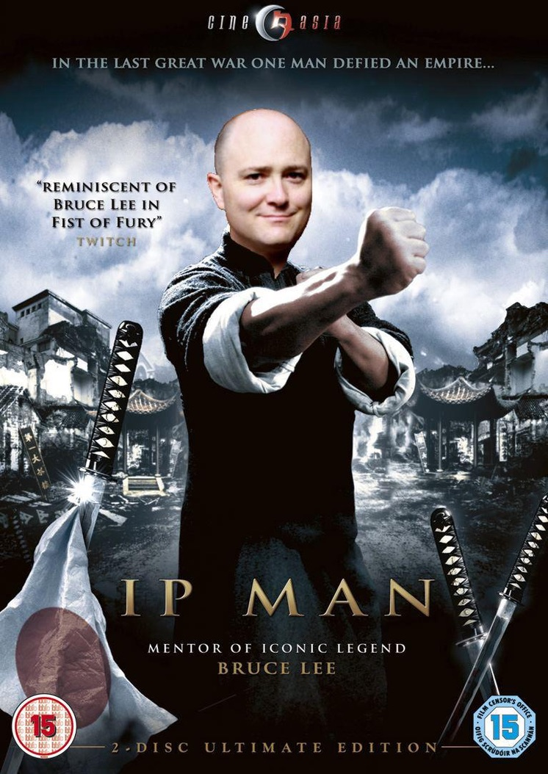
IP Man

Slide 5
How I got here
Libertarian since high school, initially influenced by Ayn Rand
Never satisfied with her case for patent and copyright
Initially practiced oil and gas law (1992) but decided to switch to patent law (1994)
Around the same time I was learning patent and IP law as a lawyer, I tried to come up with a better argument for IP
Finally I came to my current IP beliefs
I was trying to justify the unjustifiable
Heavily influenced by the work of Hoppe (on scarcity and property), and Tom Palmer & Wendy McElroy (on IP)
Hoppe was instinctively against IP from the beginning
Because I understood IP law very well, I put together what I had learned and published “Against Intellectual Property,” and many articles since

Slide 6
How I got here
I kept encountering different objections to my basic argument, so developed further arguments to explain their errors
Summarized in “Against Intellectual Property After Twenty Years: Looking Back and Looking Forward,” in LFFS
Sorting out the basic case against IP and responding to various objections required rethinking and clarifying other aspects of libertarian theory, namely the nature and purpose of property rights, contract theory, and so on
Figuring out IP and finding ways to explain it to others improved my understanding of other areas of libertarian theory
I’ve lost track of how many people have written me or told me that my IP work opened their eyes. That’s gratifying for a writer.
See “My IP Odyssey”

Slide 7
Absurd Arguments for IP
“Thank goodness the Swiss did have a Patent Office. That is where Albert Einstein worked and during his time as a patent examiner came up with his theory of relativity.” —Patent attorney Gene Quinn
“It is true that other means exist for creative people to profit from their effort. In the case of copyright, authors can charge fees for reading their works to paying audiences. Charles Dickens did this, but his heavy schedule of public performances in the United States, where his works were not protected by copyright, arguably contributed to his untimely death.” —Willliam Shughart
If you are not for IP, you must be in favor of pedophilia. —Sasha Radeta

Slide 8
Absurd Arguments for IP
If you oppose IP, you are advocating slavery. —Wildberry
“Patents are the heart and core of property rights.” —Ayn Rand
Song piracy and file-sharing are the cause of stage collapses at concerts.“
See ”Absurd Arguments for IP”
This is one of the issues where there really are no good arguments at all for IP
Similar to the drug war.
“There are No Good Arguments for Intellectual Property,” Mises Economics”
They are usually what I call “libertarian creationism,” or utilitarian, both of which are deeply flawed.

Slide 9
Summary of the Case Against IP: The Structure of Human Action
Humans act: They are aware of and uneasy about an impending future state of affairs.
They are also aware of causal laws and their ability to use available scarce means or resources, to causally interfere with the course of events, to attempt to change some future state of affairs
Note that all successful action requires the actor have scarce means at his disposal, and knowledge (of causal laws; technological and other knowledge) to guide his action

Slide 10
Summary: Property Rights and Conflict
This is true even of Crusoe, in the typical Robinsonade
Humans living with other people benefit from trade and living in society
But now there is a danger of conflict over the scarce means
Property rights emerge as a social institution to permit actors to use scarce resources without conflict

Slide 11
Summary: Property Allocation Rules
Each person owns his own body (“self-ownership”), since he has direct control over it and thus has a better claim than anyone else
For other, external, previously-unowned resources (scarce means of action), they must be able to be used first
So original appropriation (homesteading) is the primary property acquisition rule
The second rule is contract: the owner of a resource may transfer ownership or title to someone else, by gift or sale
Third rule: the owner of a resource may be required to transfer owned resources to a victim of his tort or aggression (rectification)

Slide 12
Summary: Property Allocation Rules
Thus in any dispute, which is necessarily a dispute about who is the rightful owner of some particular scarce resource, these property allocation rules suffice to specify the owner
Self-ownership; original appropriation; contractual transfer; rectification

Slide 13
Summary: IP as Negative Easement
IP rights grant to the IP “owner” a right to limit how others can use their own property
Copyright owner can prevent you from printing a book using your own paper, ink, and printing press
Patent owner can prevent a competitor from making widgets using their own factory and raw materials
Recall that both scarce means and knowledge to guide actions are required for successful human action
But conflict is possible only with respect to scarce resources, which is why property rights emerge in response to this problem
Conflict is not possible with respect to the knowledge that guides action
So property rights in information or knowledge make no sense and invariably distort and invade property rights in scarce resources

Slide 14
Property Rights as a Limit on Action
IP rights limit existing property rights
Negative easements or servitudes
“Yes, IP rights limit normal property rights, but all property rights limit other property rights”
But property rights do not limit other property rights
The very purpose of property rights is to avoid conflict
All legitimate property rights must be compossible
Property rights limit actions, not property rights
Your property right in your body is the reason why I may not perform the action of shooting you with a gun
It does not mean my property right in the gun is limited. Instead, the range of actions I may take is what is limited.
If the gun is stolen, I still may not shoot you.
This highlights that property rights are the right to exclude, not the right to use.

Slide 15
All Arguments for IP Are Confused
Once this is understood, it is easy to see the flaws in arguments for IP
“Why would I invent something?”
Questions are not arguments
“Creators deserve to be paid.”
“Copying is stealing” (or “ripping off” or “piracy” or “theft”)
“You own what you create”
What about factory workers?
And many others, too many to go into here, but I deal with them in various writings, lectures, interviews

Slide 16
Evil State Policies
War
Taxation
Central Banking
Inflation
Business cycles
Government education
Drug war
ADD TO THE LIST
Intellectual property
And unfortunately, now: Pandemic lockdowns and vaccine mandates

Slide 17
Further Reading
Kinsella, You Can’t Own Ideas: Essays on Intellectual Property (2023) [ebook]
Kinsella, ed., The Anti-IP Reader: Free Market Critiques of Intellectual Property (2023) [ebook]
a selection of critiques of IP law from a libertarian or free market perspective
Ironically it would be difficult to publish as some of the pieces are undre copyright
The IP chapters in Legal Foundations of a Free Society (2023)
I plan to write a new, comprehensive book on IP from scratch, under the title Copy This Book: The Case for Abolishing Intellectual Property
www.StephanKinsella.com
https://c4sif.org/ (Center for the Study of Innovative Freedom)

